Slide 1


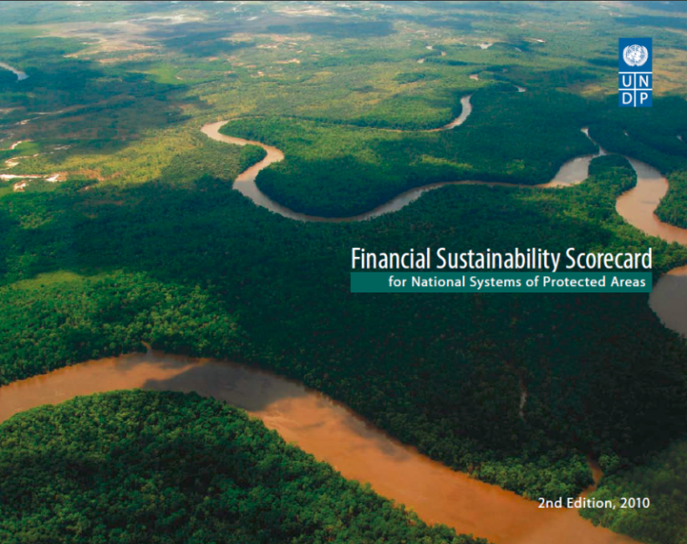

The Why, What, When & How
GEF BD -1 Tracking Tools &
Capacity Scorecard
Midori Paxton &
Doley Tshering
Regional Technical Adviser
Ecosystems and Biodiversity
CBPF-MSL Programme PPG Inception Workshop ♦ June 7, 2012

Slide 2


Overview of this Presentation
Purpose of the GEF BD Tracking Tools (TTs)
  Why?
Structure of the required GEF TTs
  What?
Summary of GEF TT requirements
  When?
Tips for completing the GEF BD TTs
  How?
Notes:
BD = biodiversity

Slide 3
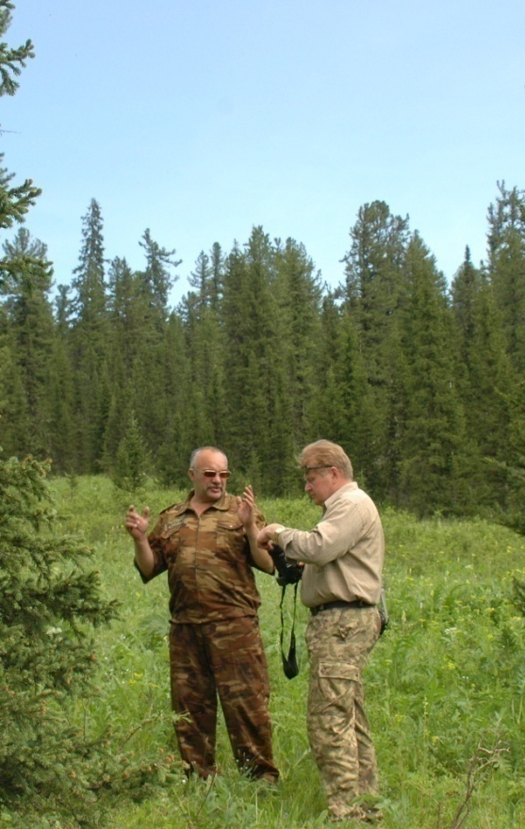
Purpose of the GEF BD Tracking Tools
To measure progress in achieving the impacts and outcomes established at the portfolio level under the biodiversity focal area
An important M&E tool
Demonstrates progress made against indicators common to all BD projects
  can also reveal shortcomings
Helps to guide and inform project implementation
Notes:
Text in green box was taken directly from GEF-5 TT Guidelines (April 2011)
Make the case for the thorough and consistent application of GEF TT

Slide 4
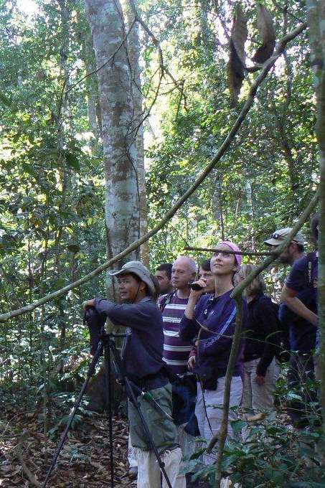
Purpose of the GEF BD Tracking Tools
Project data is aggregated for analysis of directional trends & patterns at a portfolio-wide level to inform the development of future GEF strategies and to report to
GEF Council on portfolio-level performance in the BD focal area
Allows for aggregation of results at the global level
  each project counts
  each project is counted
Aggregated results are then published by the GEF in the Annual Monitoring Report (AMR), shared with donors
  provides justification for continued investment in BD programming
Notes:
Text in blue box was taken from GEF-5 TT guidelines, though is slightly abridged.
The Annual Monitoring Review (AMR), the principal reporting tool of the GEF, provides an annual snapshot of the overall state of the GEF’s active portfolio.

Slide 5
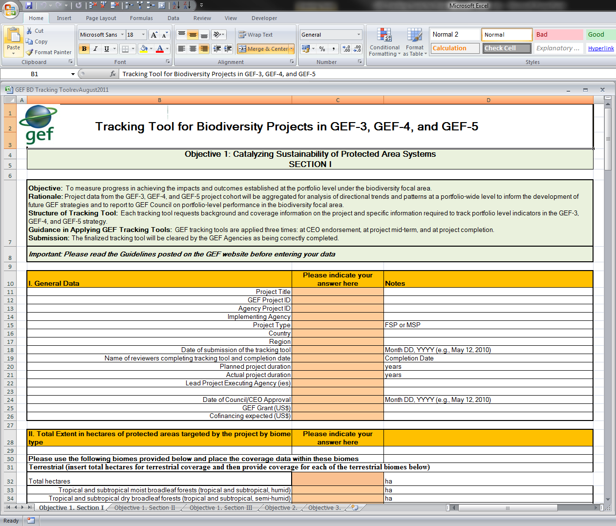
Structure of the GEF BD Tracking Tools
5 Excel spreadsheets:
  Objective 1. Section I
  Objective 1. Section II
  Objective 1. Section III
  Objective 2.
  Objective 3.
Protected
Areas
Mainstreaming
Biosafety
Notes:
Make the point that the project should complete only the TTs specific to its objective. State what TTS those are.
Sheets of the TTs not required of a project can and should be deleted from the template.

Slide 6
Structure of the GEF TTs: Protected Areas
3 Excel spreadsheets for PA projects:
  Objective 1. Section I
  Objective 1. Section II
  Objective 1. Section III
Basic Info
METT
FSC
Notes:
Basic Info sheet (Objective 1. Section I) must be completed by all projects required to do the METT and/or the FSC

Slide 7
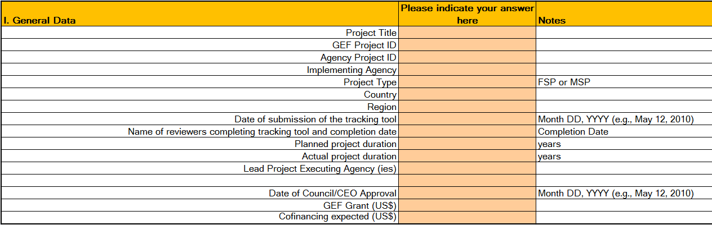
Structure of the GEF TTs: Protected Areas
Objective 1. Section I
Required of all projects that target PAs
Composed of 3 parts:
  General Data – must be completed by all projects that target PAs

Slide 8
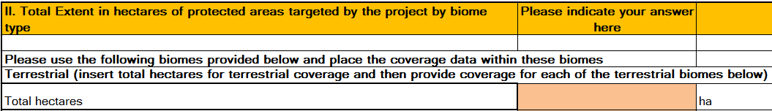
Structure of the GEF TTs: Protected Areas
Objective 1. Section I
Required of all projects that target PAs
Composed of 3 parts:
  General Data – must be completed by projects that target PAs
  Total Extent in ha of PA targeted – provide all data on biomes, as available
Notes:
projects should explain why biome data is unavailable, if that is the case
biomes not targeted should be left blank, or 0 can be entered

Slide 9
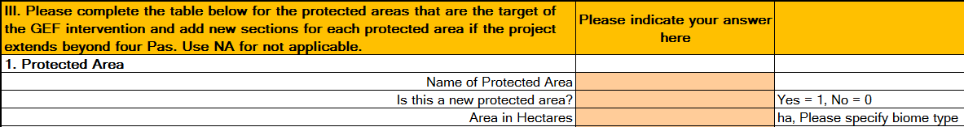
Structure of the GEF TTs: Protected Areas
Objective 1. Section I
Required of all projects that target PAs
Composed of 3 parts:
  General Data – must be completed by projects that target PAs
  Total Extent in ha of PA targeted – provide all data on biomes, as available
  Table for PAs targeted – complete 1 table for each PA targeted; duplicate tables as necessary

Slide 10
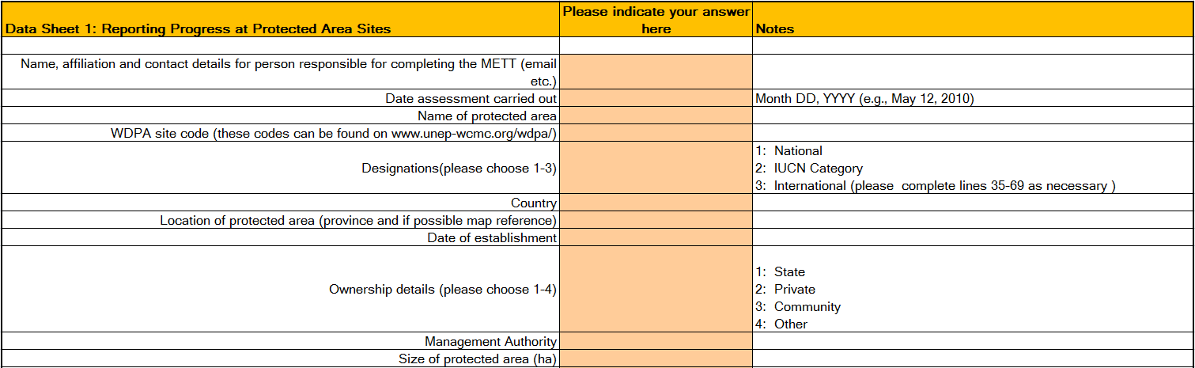
Structure of the GEF TTs: Protected Areas
Objective 1. Section II (aka METT)
Management Effectiveness Tracking Tool
Composed of 2 parts, both should be completed:
Datasheets contains 2 separate sections:
  Datasheet 1: details of the assessment, basic info on PA
Notes:
basic info such as name, size and location, and international designations
One sheet should be completed for each PA targeted by the project. Copy the sheet as many times as necessary.

Slide 11
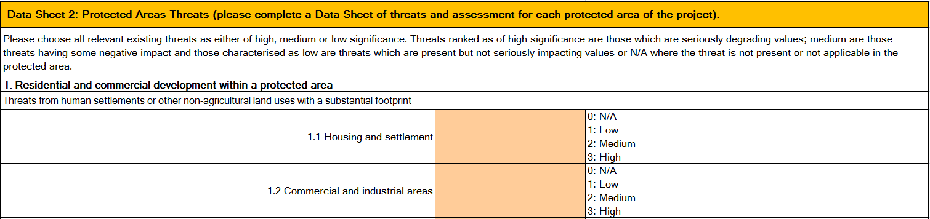
Structure of the GEF TTs: Protected Areas
Objective 1. Section II (aka METT)
Management Effectiveness Tracking Tool
Composed of 2 parts, both should be completed:
Datasheets contains 2 sections:
  Data Sheet 1: details of the assessment, basic info on PA
  Data Sheet 2: a generic list of threats that PAs face
Notes:
Datasheet 2: On this data sheet the assessors are asked to identify threats and rank their impact on the protected area.

Slide 12
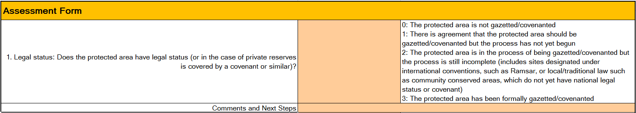
Structure of the GEF TTs: Protected Areas
Objective 1. Section II (aka METT)
Management Effectiveness Tracking Tool
Composed of 2 parts, both should be completed:
Datasheets contains 2 separate sections:
  Datasheet 1: details of the assessment, basic info on PA
  Datasheet 2: a generic list of threats that PAs face.
Assessment Form contains 30 questions, all of which should be completed
Notes:
Questions that are not applicable to the PA site should not be answered, though comments should be given to explain that the question is N/A
Comments and Next Steps should be given as much as possible.

Slide 13
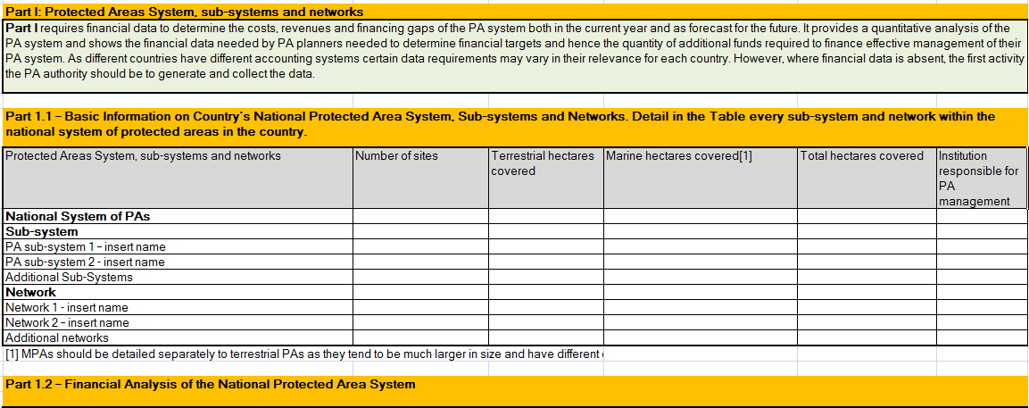
Structure of the GEF TTs: Protected Areas
Objective 1. Section III (aka FSC)
Financial Sustainability Scorecard
Composed of 3 parts, all should be completed:
Part I – Overall financial status of PA system
Notes:
Part I includes basic protected area information and a financial analysis of the national protected area system; requires financial data to determine the costs, revenues and financing gaps of the PA system both in the current year and as forecast for the future. It provides a quantitative analysis of the PA system and shows the financial data needed by PA planners needed to determine financial targets and hence the quantity of additional funds required to finance effective management of their PA system. As different countries have different accounting systems certain data requirements may vary in their relevance for each country. However, where financial data is absent, the first activity the PA authority should be to generate and collect the data.

Slide 14
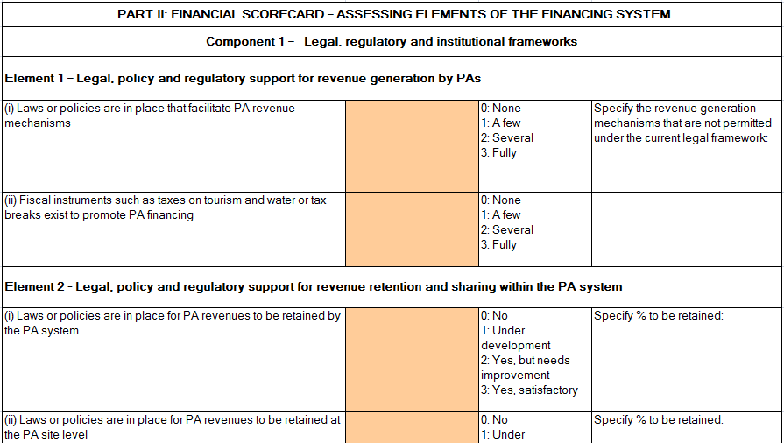
Structure of the GEF TTs: Protected Areas
Objective 1. Section III (aka FSC)
Financial Sustainability Scorecard
Composed of 3 parts, all should be completed:
Part I – Overall financial status of PA system
Part II – Assessing elements of the financing system
Notes:
Part II of the scorecard is compartmentalized into three fundamental components for a fully functioning financial system at the site and system level – (i) legal, regulatory and institutional frameworks, (ii) business planning and tools for cost-effective management (egg accounting practices) and (iii) tools for revenue generation.
COMPONENT 1: LEGAL, REGULATORY AND INSTITUTIONAL FRAMEWORKS THAT ENABLE SUSTAINABLE PA FINANCING
Legal, policy, regulatory and institutional frameworks affecting PA financing systems need to be clearly defined and supportive of effective financial planning, revenue generation, revenue retention and management. Institutional responsibilities must be clearly delineated and agreed, and an enabling policy and legal environment in place. Institutional governance structures must enable and require the use of effective, transparent mechanisms for allocation, management and accounting of revenues and expenditures.
COMPONENT 2: BUSINESS PLANNING AND TOOLS FOR COST-EFFECTIVE MANAGEMENT
Financial planning, accounting and business planning are important tools for cost-effective management when undertaken on a regular and systematic basis. Effective financial planning requires accurate knowledge not only of revenues, but also of expenditure levels, patterns and investment requirements. Options for balancing the costs/revenues equation should include equal consideration of revenue increases and cost control. Good financial planning enables PA managers to make strategic financial decisions such as allocating spending to match management priorities, and identifying appropriate cost reductions and potential cash flow problems. Improved planning can also help raise more funds as donors and governments feel more assured that their funds will be more effectively invested in the protected area system.
COMPONENT 3: TOOLS FOR REVENUE GENERATION AND MOBILIZATION
PA systems must be able to attract and take advantage of all existing and potential revenue mechanisms within the context of their overall management priorities. Diversification of revenue sources is a powerful strategy to reduce vulnerability to external shocks and dependency on limited government budgets. Sources of revenue for protected area systems can include traditional funding sources – tourism entrance fees – along with innovative ones such as debt swaps, tourism concession arrangements, payments for water and carbon services and in some cases, carefully controlled levels of resource extraction.

Slide 15
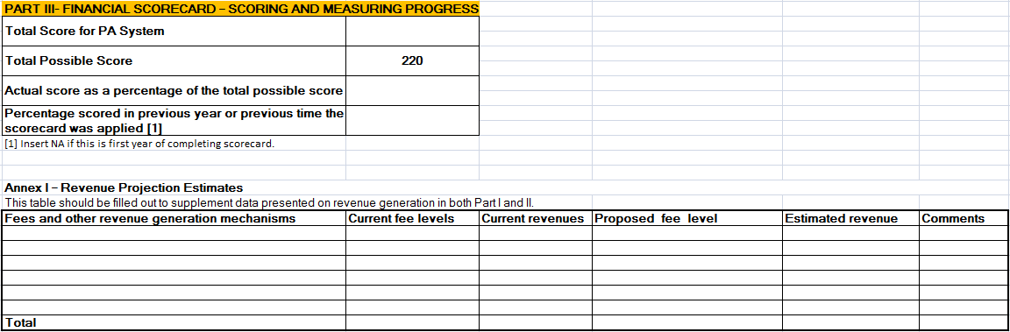
Structure of the GEF TTs: Protected Areas
Objective 1. Section III (aka FSC)
Financial Sustainability Scorecard
Composed of 3 parts, all should be completed:
Part I – Overall financial status of PA system
Part II – Assessing elements of the financing system
Part III – Scoring
Notes:
Part III summarizes the total scores and percentages scored by the country in any given year when the exercise is completed. It shows the total possible score and the total actual score for the PA system and presents the results as a percentage. Over time changes to the scores can show progress in strengthening the PA financing system.

Slide 16
Part II: UNDP Capacity Scorecard
UNDP’s definition and approach to CD
Key elements of the CD scorecard for BD projects
Example of a completed CD Scorecard
Notes:
BD = biodiversity

Slide 17

UNDP Definition of CD
Capacity Development: The process through which individuals, organizations and societies obtain, strengthen and maintain the capabilities to set and achieve their own development objectives over time
Notes:
Facilitator’s note:
Explain that different development agencies might have slightly different definitions, but all “modern” CD theories express similar concepts;
Ask/explain what is the difference (for UNDP) between Capacity Development and Capacity Building (see sub-note) and why we use CD (you can note it on a Flip Chart or Manila Paper).
Sub-note:
Capacity Development commonly refers to the process of creating and building capacity and their (subsequent) use, management and retention. The process is driven from the inside and starts from existing national capacity assets.
Capacity Building commonly refers to the process that supports only the initial stages of building or creating capacities and alludes to the assumption that there are no existing capacities to start from It is therefore less comprehensive then CD and suggest a process starting with a plain surface and involving the erection of a new structure on a preconceived design. Possibly relevant to immediate post-conflict situations.

Slide 18
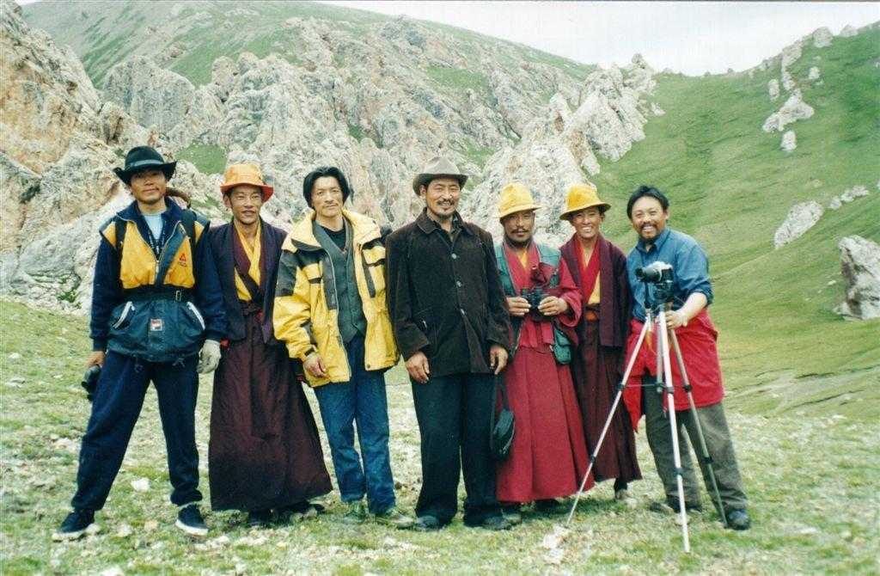
Types of capacities
  Functional capacities: which cut across all sectors:
    « to engage stakeholders »
    « to assess a situation and define a vision »
    « to formulate policies and strategies »
    « to budget, manage and implement »
    « to monitor and evaluate »
  Technical capacities: areas of expertise such as education, health, agriculture, etc.

Slide 19

CD at 3 levels: a systems approach
Notes:
The enabling environment :
is the broad social system within which people and organizations function. It includes all the rules, laws, policies, power relations and social norms that govern civic engagement. It is the enabling environment that sets the overall scope for capacity development.
The organizational level :
refers to the internal structure, policies and procedures that determine an organization’s effectiveness. It is here that the benefits of the enabling environment are put into action and a collection of individuals come together. The better resourced and aligned these elements are, the greater the potential for growing capacity.
At the individual level :
are the skills, experience and knowledge that allow each person to perform. Some of these are acquired formally, through education and training, while others come informally, through doing and observing. Access to resources and experiences that can develop individual capacity are largely shaped by the organizational and environmental factors described above, which in turn are influenced by the degree of capacity development in each individual.

Slide 20
UNDP CD Scorecard: Key elements
Aim: to assess the development of capacities vis-à-vis the management of protected areas
Strategic areas of support: 5 categories @ 3 levels (systemic, institutional and individual)
  Capacity to conceptualize and formulate policies, legislations, strategies and programs
  Capacity to implement policies, legislation, strategies and programs
  Capacity to engage and build consensus among all stakeholders
  Capacity to mobilize information and knowledge
  Capacity to monitor, evaluate, report and learn
Indicators: used to specify what capacities need to be developed (see example later)
Scoring: how to
  Worst (0); Marginal (1); Satisfactory (2); Best (3)
  Baseline, target and total possible scores
  Present as percentage of TPS
Notes:
Example of indicators:
There is a strong and clear legal mandate for establishment and management of PAs (CD1/S)
There is an institution responsible for protected areas able to strategize and plan (CD1/Is)
There are adequate skills for PA planning and management (CD2/S)
Protected areas institutions are effectively led (CD2/Is)
Individuals are appropriately skilled for their jobs (CD 2/Id)

Slide 21
Example of a completed detailed scorecard
Strategic Area of Support | Capacity Level | Indicator | Scores
 |  |  | Worst (Score 0) |  | Marginal (Score 1) |  | Satisfactory (Score 2) |  | Best (Score 3)
1. Capacity to conceptualize and formulate policies, legislations, strategies and programmes | Systemic | There is a strong and clear legal mandate for mainstreaming biodiversity into production sector activities in the EGREE | There is no legal framework for biodiversity mainstreaming into production sector activities |  | There is a partial legal framework for biodiversity mainstreaming into production sector activities, but it has many inadequacies |  | There is a reasonable legal framework for biodiversity mainstreaming but it has a few weaknesses and gaps | 2 | There is a strong and clear legal mandate for biodiversity mainstreaming into production sector activities
1. Capacity to conceptualize and formulate policies, legislations, strategies and programmes | Institutional | There is a multi-sectoral institutional mechanism responsible for mainstreaming biodiversity concerns into production sector activities in the EGREE that is able to prepare effective strategies and plans to this end | There is no multi-sectoral institutional mechanism responsible for mainstreaming biodiversity concerns into production sector activities in the EGREE | 0 | There is a multi-sectoral institutional mechanism responsible for mainstreaming biodiversity concerns into production sector activities in the EGREE but there is no clear strategy to this end |  | There is a multi-sectoral institutional mechanism responsible for mainstreaming biodiversity concerns into production sector activities in the EGREE, and there is an initial strategy to this end |  | There is a multi-sectoral institutional mechanism responsible for mainstreaming biodiversity concerns into production sector activities in the EGREE, and there is a regularly updated strategy developed through wide stakeholder participation
2. Capacity to implement policies, legislation, strategies and programmes | Systemic | There are adequate skills for mainstreaming biodiversity into production sector activities in the EGREE | There is a general lack of skills |  | Some skills exist but in largely insufficient quantities to guarantee effective biodiversity mainstreaming | 1 | Necessary skills for effective biodiversity mainstreaming into production sector activities do exist but are stretched and not easily available |  | Adequate quantities of the full range of skills necessary for effective biodiversity mainstreaming into production sector activities are easily available

Slide 22
Example – total possible scores
Strategic Areas of Support | Total Possible Scores
 | Systemic | Institutional | Individual
1. Capacity to conceptualize and formulate policies, legislations, strategies and programme | 3 | 3 | -
2. Capacity to implement policies, legislation, strategies and programmes | 6 | 9 | 6
3. Capacity to engage and build consensus among all stakeholders | 6 | 3 | -
4. Capacity to mobilize information and knowledge: Technical skills related specifically to the requirements of GEF SO-2 and SP-4 | 3 | - | 3
5. Capacity to monitor, evaluate and report and learn at the sector and project levels | 3 | 3 | -
Total | 21 | 18 | 9
Note: "-" means no indicator was selected for that level.

Slide 23
Example – summary baseline scores
Strategic Areas of Support | Baseline Scores
 | Systemic | Institutional | Individual
1. Capacity to conceptualize and formulate policies, legislations, strategies and programme | 2 | 0 | -
2. Capacity to implement policies, legislation, strategies and programmes | 2 | 1 | 1
3. Capacity to engage and build consensus among all stakeholders | 1 | 0 | -
4. Capacity to mobilize information and knowledge: Technical skills related specifically to the requirements of GEF SO-2 and SP-4 | 1 | - | 1
5. Capacity to monitor, evaluate and report and learn at the sector and project levels | 1 | 1 | -
Total | 7 | 2 | 2
Note: "-" means no indicator was selected for that level.

Slide 24
Example – summary target scores
Strategic Areas of Support | Target Scores
 | Systemic | Institutional | Individual
Capacity to conceptualize and formulate policies, legislations, strategies and programme | 3 | 3 | -
2. Capacity to implement policies, legislation, strategies and programmes | 6 | 7 | 6
3. Capacity to engage and build consensus among all stakeholders | 5 | 3 | -
4. Capacity to mobilize information and knowledge: Technical skills related specifically to the requirements of GEF SO-2 and SP-4 | 3 | - | 3
5. Capacity to monitor, evaluate and report and learn at the sector and project levels | 3 | 3 | -
Total | 20 | 16 | 9
Note: "-" means no indicator was selected for that level.

Slide 25
Baseline scores as % of TPS
Strategic Areas of Support | Baseline Scores as % of TPS
 | Systemic | Institutional | Individual
1. Capacity to conceptualize and formulate policies, legislations, strategies and programme | 67% | 0% | -
2. Capacity to implement policies, legislation, strategies and programmes | 33% | 11% | 17%
3. Capacity to engage and build consensus among all stakeholders | 17% | 0% | -
4. Capacity to mobilize information and knowledge: Technical skills related specifically to the requirements of GEF SO-2 and SP-4 | 33% | - | 33%
5. Capacity to monitor, evaluate and report and learn at the sector and project levels | 33% | 33% | -
Total | 33% | 11% | 22%
Note: "-" means no indicator was selected for that level.

Slide 26
Target scores as % of TPS
Strategic Areas of Support | Target Scores as % of TPS
 | Systemic | Institutional | Individual
1. Capacity to conceptualize and formulate policies, legislations, strategies and programme | 100% | 100% | -
Capacity to implement policies, legislation, strategies and programmes | 100% | 78% | 100%
3. Capacity to engage and build consensus among all stakeholders | 83% | 100% | -
4. Capacity to mobilize information and knowledge: Technical skills related specifically to the requirements of GEF SO-2 and SP-4 | 100% | - | 100%
5. Capacity to monitor, evaluate and report and learn at the sector and project levels | 100% | 100% | -
Total | 95% | 89% | 100%
Note: "-" means no indicator was selected for that level.

Slide 27
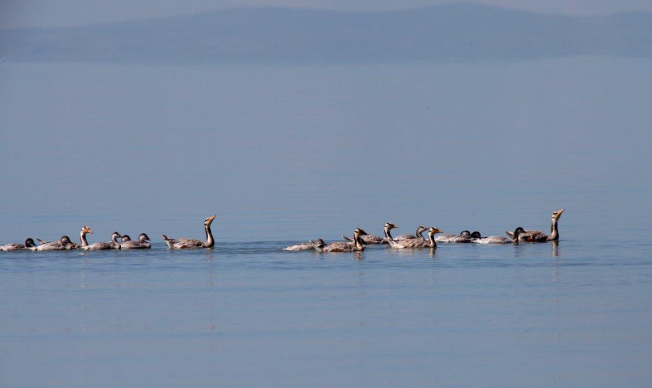
In summary
  CD – a systems approach is necessary
  CD – it is about both functional and technical capacities
  CD scorecard – measures project CD interventions against a ideal (TPS) scenario, with measured baselines and appropriate target values
  As detailed as possible; use only relevant indicators

Slide 28
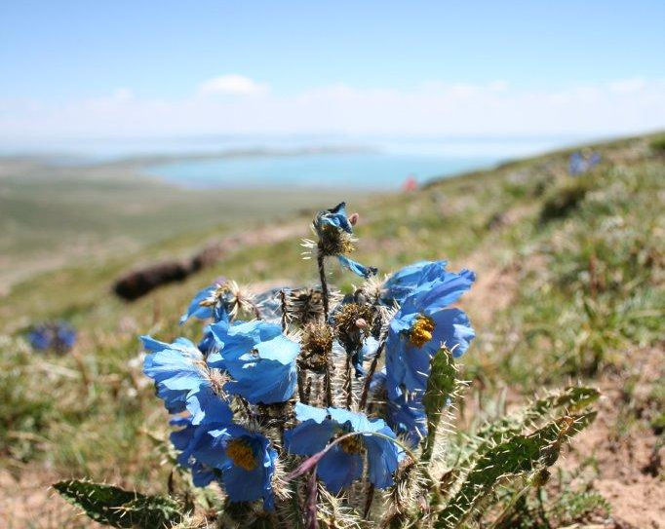
Thank you

